Slide 1
Creep Test
Creep is the tendency of a solid material to slowly deform permanently under the influence of stresses at high temperature but can also happen at room temperature in certain materials (e.g. lead or glass).
Creep test is carried out to investigate any dimensional changes of specimen with time when subjected to a constant load at a high temperature (> 0.4 Tm).
High Temp Behavior of Materials:
Mechanical degradation
Chemical Degradation
High temperature materials problem
Atoms move faster diffusion-controlled process. This affects mechanical properties of materials.
Greater mobility of dislocations.
Increased amount of vacancies.
Deformation at grain boundaries.
Metallurgical changes, i.e., phase transformation, precipitation, oxidation, recrystallisation.
Engineering application: turbine blades, steam generators.
Creep limit: Maximum stress which doesn't cause significant deformation at the given temperature.
The Critical Temperature for Creep is 40% of the Melting Temperature.
T_{m} = Melting temperature

Slide 2
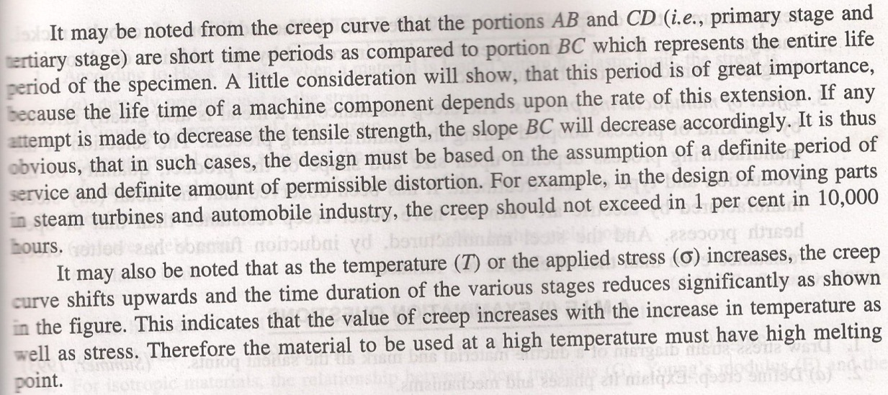
Effects of Stress and Temperature

Slide 3
Figure 1: creep curves with stress and temperature effects
So with Increasing stress or temperature:
The instantaneous strain increases
The steady-state creep rate increases
The time to rupture decreases

Slide 4
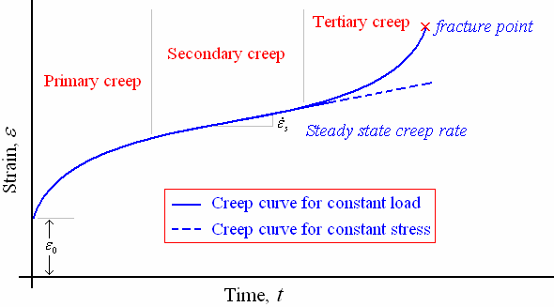
Stages of creep curve
Most creep tests are conducted at constant load in analogous to engineering application, whereas creep tests at constant stress are necessary for understanding of mechanism of creep.
Figure 2 shows a typical creep curve with three stages of creep. The slope of the creep curve is designated as creep rate.
Δε/Δt
(creep rate)
ε₀ → Initial instantaneous strain
ε_{o} is instantaneous strain on loading which is partly recoverable with time (anelastic) and partly nonrecoverable with time (plastic).
Figure 2: Typical creep curve

Slide 5
A typical creep curve shows three distinct stages with different creep rates. After an initial rapid elongation ε_{o}, the creep rate decrease with time until reaching the steady state.
1) Primary creep stage is a period of transient creep and provides decreasing creep rate. The creep resistance of the material increases due to material deformation.
2) Secondary creep stage gives the representing constant creep rate and is believed to be due to balance between the competing processes of strain hardening and recovery. The minimum creep rate is the most important design parameter derived from the creep curve. It is the engineering design parameter that is considered for long-life applications.
3) Tertiary creep stage yields a rapid creep rate till failure. It is believed to occur because of either reduction in cross-sectional area due to necking or internal void formation. Third stage is often associated with metallurgical changes such as coarsening of precipitate particles, recrystallization, or diffusional changes in the phases that are present

Slide 6
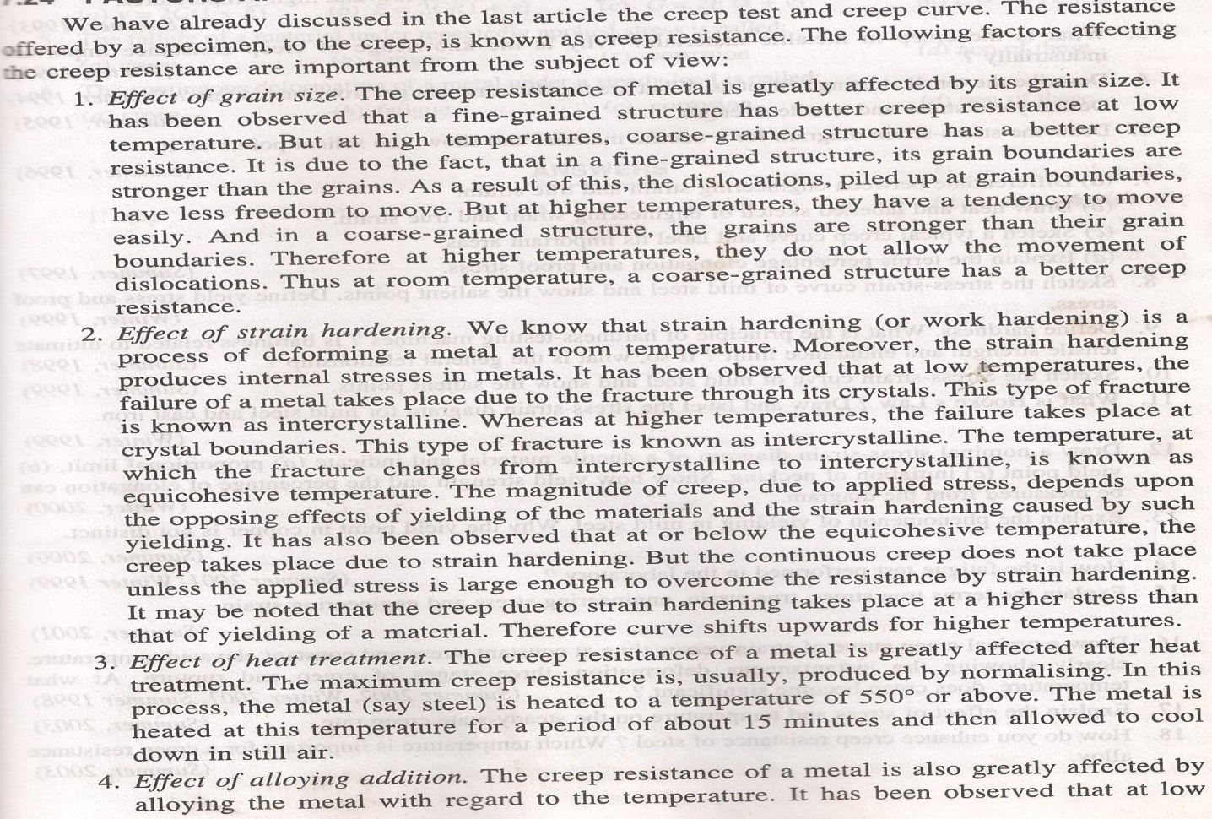
Factors affecting creep resistance

Slide 7
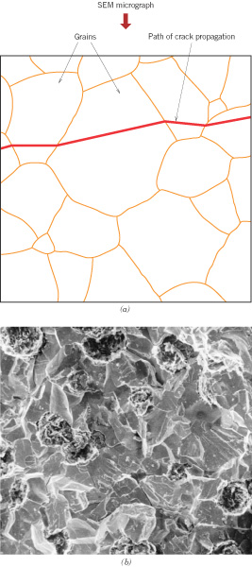
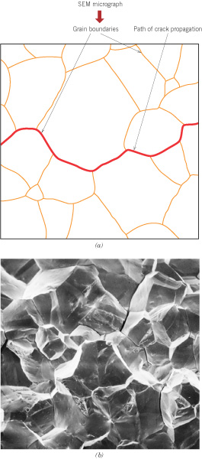
Trancrystalline Creep Fracture
Intercrystalline Creep fracture

Slide 8
